Slide 1
INTRODUCTION TO .NET

Slide 2
What will be Covered
What is computer programming
Different types of application
How computer programs Works
Programming Methodologies
Algorithm, Pseudocode, Programs and Flowcharts
Introduction to .NET Framework
.NET Framework Architecture and components
Introduction to C# Programming Language
How to Download and install Visual studio
First console application

Slide 3
History Time
Before C# there were tow languages in the C family :c and c++.
When we compiled code with any of the above the compiler compiled our code to native code for the machine its running on e.g.(windows or macOS)
But we have different hardware's , and that means that the above wont be possible.
C# however changed that

Slide 4
What is Computer Programming
A language is a way to communicate with each other. It involves exchanging a set of instruction from one person to another.
A computer language is also a set of instructions that the computer can understand, it’s a formal language used to communicate with a computer.
We need to communicate with computers too in order for it to help us do complex computations (e.g. the factorial of 100). But the problem is that a computer understands Binary language(o’s and 1’s) and we human understands different languages (i.e. English, Chinese ).
If we want to talk to the computer we should pass instructions in machine code or binary code but do we understand binary code

Slide 5

If you want to pass instruction to a computer you need to learn a programming language like C, C++, Java , JavaScript and C# (high-level programming languages)
So to communicate we write programs using any programming language , so we have to study the language first and write programs ( which is just a set of instructions) but we don’t yet have machine Code?
Programs get converted by the compiler and generate machine code and not the computer can receive input and provide output.

Slide 6
Types of Programming Languages
Machine Language – This is the language that the computer understands, it involves a series of binary 0’s and 1’s
Assembly Language – This is a low-level programming language but easier than machine language( used to develop OS)
High-level Languages- the low-level programming languages are hard to learn so we wanted some English-like language so high-level programming languages were introduced like : C, C++,C#,JS , Java and Python.\
Problem-oriented Languages – this include SQL
Natural languages – mainly used in Artificial intelligence

Slide 7
Programming Methodologies
Monolithic Programming
The program code is present in a single block without any divisio of code int functions.
It has some drawbacks :
It is hard to reuse, debug
It is large and complex
Repetition of code
Maintainability is hard

Slide 8
Procedural Programming
In this paradigm the code is written in separate blocks and not in a single block and we can reuse the program whenever we want without repeating code.
Advantage
It allows easy development of software and application by splitting down a program into smaller programs to execute a variety of tasks.
It increases the readability of code and makes it easier to understand the code.
It increases the reusability of code so that a particular piece of code can be used multiple times in a program whenever required.
It can be used to write bigger and more complex programs.
A team of programmers can work simultaneously and hence big projects can be done easily.
It is easy to understand the program

Slide 9
Object-Oriented Programming (OOP)
OOP is written in form of classes that contain different data members and members functions ,and data grouped together. We can create objects from these classes .
Advantages pf OOP
We can build the programs from standard working modules that communicate with one another, rather than having to start writing the code from scratch which leads to saving development time and higher productivity.
OOP language allows breaking the program into bit-sized problems that can be solved easily (one object at a time).
OOP systems can be easily upgraded from small to large systems.
The new technology promises greater programmer productivity, a better quality of software, and lesser maintenance cost.
In OOPs, the code is distributed on a large scale that shows a higher level of abstraction.
The class contains data and functions so the complexity is within the class, the programmer deals with the entire class.
Reusability of the class within the code and outside the code is a big advantage.

Slide 10
Introduction to the .NET Framework
NET stands for Network Enabled Technology (Internet). In .NET, dot (.) refers to Object-Oriented, and NET refers to the internet. So, the complete .NET means through Object-Oriented we can implement internet-based applications.
According to Microsoft, .NET is a Free, Cross-Platform, Open-Source developer platform for building many different types of applications. With .NET, we can use multiple languages (C#, VB, F#, etc.), Editors (Visual Studio, Visual Studio Code, Visual Studio for Mac, OmniSharp, JetBrains Rider, etc.), and Libraries to build for Web, Mobile, Desktop, Games, IoT, and more.
Cross Platform: Whether you are working in C#, F#, or Visual Basic, your code will run on any compatible operating system. You can build many types of apps with .NET. Some are Cross-Platform, and some target a specific set of operating systems and devices.
Libraries: To extend functionality, Microsoft and others maintain a healthy .NET package ecosystem. NuGet is a package manager built specifically for .NET that contains over 100,000 packages.

Slide 11
What Does the .NET Framework Provide
The .NET framework provides two component:
BCL (Base Class Libraries)
CLR (Common Language Runtime)
What is BCL
The Base Class Library is installed ehen we install the .NET framework . It provides a set of API’s and types for common functionality e.g. types for string, date, numbers
BCL is a collection of pre-written code that provides many useful tools and building blocks form programmers when they are building their programs .
(toybox)

Slide 12
What is the CLR
CLR is the execution engine that handles running applications, it provides services like garbage collection, treading , exception handling and more.
Its main work is to ensure that the programs you write in the .NET framework works properly.( babysitter)
CLR Consist of a JIT compiler which is responsible for executing the Intermediate Code into Byte Code.
The garbage collector manages the allocation and release of memory for an application. Therefore, developers working with managed code don’t have to write code to perform memory management tasks. Automatic memory management can eliminate common problems such as forgetting to free an object and causing a memory leak or attempting to access freed memory for an object that’s already been freed.

Slide 13
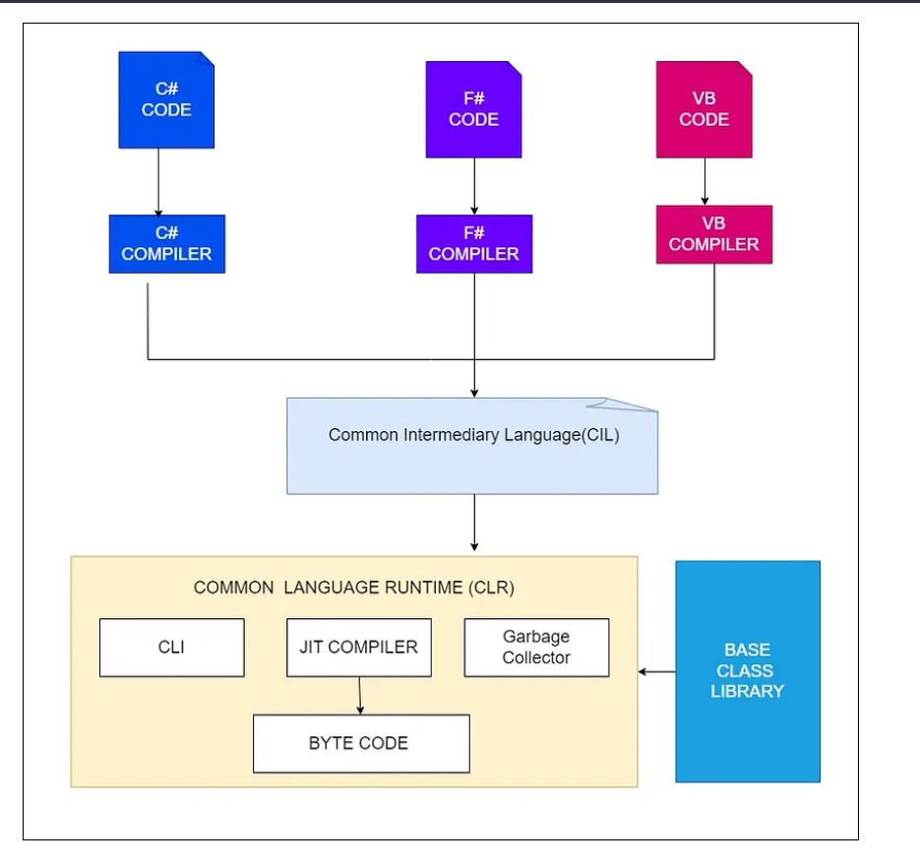
C# Code Compilation and Execution

Slide 14
In the .NET framework, the code is compiled twice.
In the 1st compilation, the source code is compiled by the respective language compiler and generates the intermediate code which is known as MSIL (Microsoft Intermediate Language) or IL (Intermediate language code), or Managed Code.
In the 2nd compilation, MSIL is converted into Native code (native code means code specific to the Operating system so that the code is executed by the Operating System) and this is done by CLR inside the JIT compiler
Always 1st compilation is slow and 2nd compilation is fast.

Slide 15
CLR Features
Memory Management: The CLR automatically manages memory allocation and garbage collection, which helps prevent memory leaks and ensures efficient memory usage.
Security: The CLR provides a secure execution environment for .NET applications, with features like code access security and verification.
Just-in-Time (JIT) Compilation: The CLR compiles .NET code to machine code at runtime, which helps improve performance by optimizing code based on the current system and environment.
Cross-Language Interoperability: The CLR supports multiple programming languages, and allows code written in different languages to work together seamlessly.
Exception Handling: The CLR provides a robust exception handling mechanism that helps developers handle errors and exceptions more easily.
Debugging: The CLR includes tools for debugging .NET applications, making it easier for developers to identify and fix issues in their code.
Threading: The CLR provides a multi-threading environment that allows applications to take advantage of multiple processors or cores, improving performance and scalability.

Slide 16
Different Types of the .NET Framework
.NET Framework: .NET Framework is the original implementation of .NET. It supports running websites, services, desktop applications, and more on Windows OS Only.
.NET: .NET is a cross-platform implementation for running websites, services, and console applications on Windows, Linux, and macOS. .NET is open source on GitHub and .NET was previously called .NET Core.
Xamarin/Mono: Xamarin/Mono is a .NET implementation for running apps on all the major mobile operating systems, including iOS and Android.

Slide 17
What is Exactly .NET?
.NET is a framework tool that supports many programming languages and many technologies. .NET support 60+ programming languages. Of 60+ programming languages,11 are designed by Microsoft and the remaining are designed by non-Microsoft. Microsoft-designed programming languages are as follows:
VB.NET
C#.NET
VC++.NET
J#.NET
F#.NET
Jscript.NET
WindowsPowerShell
Iron phyton
Iron Ruby

